Slide 1





10/2025
Life to Eagle
Page 1
For Eagle Scout Candidates, Unit Leaders and Parents/Guardians
Blue Hen District
Del-Mar-Va Council
Dan White, Andy Sensing - Eagle Board Chairs
This document is for reference only and subject to change. Review the most updated documents on the official BSA websites for current information.

Slide 2


Today’s Objectives
Eagle Feathers
Eagle Scout Rank Requirements
Eagle Scout Service Project
Eagle Scout Rank Application

Slide 3
Session Goals
Objectives
to inspire you to take action!
to learn the Life to Eagle Process
to learn how to start and complete your Eagle Project
to learn what documentation must be submitted for Eagle Rank consideration

Slide 4



Eagle Feathers
The Rank of Eagle tells others about OUR Character
Skill
Leadership ability
The Rank of Eagle is time limited - Beware the 4 G’s
Grades – Gas – Games – Girls/Guys … Plus Jobs and Sports
The Eagle rank is also a serious consideration for college entrance accomplishments and military recruiters.

Slide 5

Significance of the Eagle Scout Rank
The average age of Scouts earning the Eagle Scout rank is 17.3 years of age
Over 8.5 million hours of work on projects
About 3,000,000 Eagle Scouts since 1912
In 1912, there were 23 Eagles. There were only 5 merit badges required (Athletics, First Aid, Life Saving, Personal Health, Public Health).
About 3% of all eligible Scouts since 1912

Slide 6
Be Aware……
NO Council, District, Unit or Individual has the authority to ADD to or SUBTRACT
from any BSA advancement requirement.

Slide 7


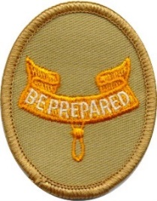



To Achieve the Eagle Scout Rank a Scout Must
Earn six prior Scouting Ranks
Meet about 55 achievement requirements
Satisfactorily complete several hundred tasks
Be reviewed by Adult Scouters at the Unit, District, Council and National level dozens of times

Slide 8
Steps to Eagle
In order to advance to the rank of Eagle, a candidate must complete all requirements:
Active participation
Scout principles and spirit
Merit badges
Positions of responsibility
While a Life Scout, plan, develop, and provide leadership to others in a service project
Scoutmaster conference
Board of Review

Slide 9

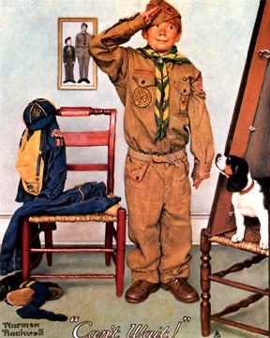
Requirement 1. Participation
Be active in your troop, team, crew, or ship for a period of at least six months after you have achieved the rank of Life Scout.
Mastery of Scouting skills & personal character growth cannot happen without participation.
Participation goals may vary from unit to unit.

Slide 10
Requirement 1. Participation
Since we prepare young people to go forth, and essentially, make a positive difference in our American society, we judge that a member is “active” when his/her level of activity in Scouting, whether high or minimal, has had a sufficiently positive influence toward this end.
1. The Scout is registered.
2. The Scout is in good standing.
3. The Scout meets the unit’s reasonable expectations,
or, if not, a lesser level of activity is explained.
If a Scout has fallen below their unit’s activity-oriented expectations, then it must be due to other positive endeavors—in or out of Scouting—or to noteworthy circumstances that have prevented a higher level of participation. In this case a Scout is considered “active” if a Board of Review can agree that Scouting values have already taken hold and been exhibited.

Slide 11
Requirement 2. Scout Spirit
As a Life Scout, demonstrate that you live by the principles of the Scout Oath and Scout Law in your everyday life and tell how you have done your duty to God. List the names of individuals who know you personally and would be willing to provide a recommendation on your behalf.
Scouting ideals are reflected in the character of an Eagle.
He or she sets the example, not only in the Scouting setting, but in every facet of their life.

Slide 12
Requirement 2.
Letters of Recommendation
List the names of individuals who know you personally and would be willing to provide a recommendation on your behalf. These may be Scout leaders, teachers, employers, coaches, other Scouts, etc. References do not need to be 21 or older. Parents and other relatives are strongly discouraged from serving as references. The current unit leader and committee chair are not eligible to serve as references.
You will list these on your Eagle Scout Rank Application.
You will ask these people to write letters of recommendation to be attached to your Eagle Application.

Slide 13
Req. 2. Scout Spirit Cont. - References
The Board of Review requests reference letters to be provided by the unit leader to the Eagle Board Chair.
The Scout is responsible for requesting references from the four people listed on the application—this is a valuable life skill. Electronic submissions are allowed but confidentiality must be maintained.
Requested references should be sent to a designated unit leader (SM or AC) in advance of the Eagle Board of Review
Although the Scout may assist with any contacts that do not respond, it is the responsibility of the unit to follow-up, not the Scout’s

Slide 14


Requirement 3. Skills
Earn a total of 21 merit badges (14 required badges). List the month, day, & year the merit badge was earned.
The Merit Badge Program promotes:
Basic character-developing tools Opportunity to learn career skills Develop physical fitness…
Hobbies and interests for a lifetime
Contact with adults with whom you may not be acquainted
All requirements must be completed prior to 18th b-day Eagle application dates must match Council Records

Slide 15






Requirement 3. Merit Badges
Camping
Citizenship in the Community
Citizenship in the Nation
Citizenship in the World
Citizenship in Society
Cooking
Communications
Personal Fitness
Emergency Preparedness OR Lifesaving
Environmental Science OR Sustainability
Family Life
First Aid
Personal Management
Swimming OR Hiking OR Cycling
Requirement 3.
These 14 are merit badges required for the Eagle rank.
Notes:
9/15/2008

Slide 16

Requirement 4. Leadership
While a Life Scout, serve actively for a period of six months in one or more of the following positions of responsibility.
May be elected by peers or assigned by the Scoutmaster
6 Months is the MINIMUM, more than one position may be held On the Eagle Application list only positions held while a Life Scout
Serve Actively means: Must do the job - Not just wear the patch Approved troop positions are: (Venturing Crew- Check latest Eagle Scout Application)
Senior Patrol Leader | Troop Scribe | Patrol Leader | Instructor
Asst. Senior Patrol Leader | Troop Librarian | Chaplain aide | OA Rep
Jr Asst. Scoutmaster | Troop Historian | Den Chief | Troop Guide
Outdoor Ethics Guide | Webmaster | Troop Quartermaster
The Scoutmaster may assign a special leadership project in place of a Position of Responsibility - for Star and Life, NOT for Eagle.

Slide 17

Requirement 5. ESSP
While a Life Scout, plan, develop, and give leadership to
others in a service project helpful to any religious institution, any school, or your community. (The project must benefit an organization other than the BSA.) A project proposal must
be approved by the organization benefiting from the effort, your unit leader and unit committee, and the council or district before you start. You must use the Eagle Scout Workbook (latest version 2023a – 2/23), in meeting this requirement. (To learn more about the Eagle Scout service project, see the Guide to Advancement, section 9)
Demonstrating PLANNING & LEADERSHIP, through service, is still the objective.
The Scout: Plans, Develops, and Leads others….
The Unit: Provides mentorship so that the Scout can do his very best at planning and executing this requirement.
The District: Reviews the ESSP Proposal for Community Benefit, Leadership Opportunity commensurate with the rank of Eagle Scout, and the candidate’s understanding of further planning. Approves the proposal when it is ready.
All of the Scouting methods, training, experience, and YOUR skill are being “tested” by this requirement.

Slide 18

Eagle Scout Service Project
Cannot be routine labor or benefit a commercial business.
Must have opportunity for Planning, Development and Leadership.
Must benefit religious institute, any school, charity, or your community. NOT BSA
May NOT be a “fund raiser”
Fund-raising is permitted only for securing materials needed to carry out the project.
Donors to projects must be made aware of what entity is benefiting from the project, and that it clearly is not the Boy Scouts of America.
Any funds raised for a project and not used for the purchase of project materials must go to the beneficiary.
A Scout is thrifty… they help to pay their own way
Must be planned and carried out by one Scout - no joint projects
Can take 3-12 months to complete - plan ahead! A key lesson most candidates learn is that they can’t control other people’s schedules
Must take place while a Life Scout

Slide 19
ESSP - Overall Process
Generate 2-3 possible ideas (internet, previous projects, leaders, interest or passion of Scout, religious organization, troop sponsor)
Discuss ideas with your Unit Leader, Coach, Mentor, and Beneficiary Rep Consider Leadership Opportunity, Community Value and Project Scope Obtain initial approval from Unit Leadership & Beneficiary
Put together a project PROPOSAL
Detail planning is not necessary prior to approval
Must use most recent official ESSP Workbook (02/2023 latest) (not compatible with Chromebook OS).
Obtain Approvals: THE CANDIDATE SIGNS COMMITMENT
1) Unit Leader, 2) Unit Committee, 3) Beneficiary
4) District Advancement Committee (last, email to Eagle Board Chair, Dan White - 70Eagle279@gmail.com or Andy Sensing – asensing@aol.com
Develop the detail plan
Submit plan to approvers for review (not additional approval)
Execute the Plan
Record Changes & Complete ESSP Workbook

Slide 20
ESSP – *Beneficiary approval!!!
Prior to selecting your project make sure to find a beneficiary you can work with and will provide the guidance you will need on what they are looking for.
Make sure the person you are working with can make decisions on the behalf of the beneficiary organization. You cannot begin work until the beneficiary signs off on your project.
Communication with the beneficiary should be maintained at all times to make sure your work and the beneficiary’s visions are aligned. Also make sure that you avoid ”project creep”. Stick to the approved plan. If the beneficiary requests additional work it must be in the scope of the project.
If your project deviates significantly from your plan, you will need to consult the Eagle Project committee and potentially the District Eagle Board Chair.

Slide 21
Eagle Scout Service Project
Before You start
After completion
Carrying out the project
Project Concept
Project Proposal
Approval
What?
Who?
Where?
Why?
When?
How?
Project Final Plan
Project Plan
Record Progress of Project:
Hours
Materials
Changes
Photos
Leadership
Service Project Report
Approvals of Completed Project
Project & Board of Review
Notes:
9/15/2008

Slide 22
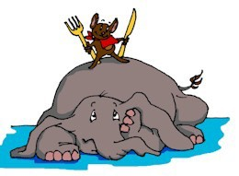
ESSP - Writing the Proposal Overview
First step in Project
Use the February 2023 (or most current version) ESSPW #2023a - Instructions are on Page 3-4 (Read the entire workbook)
Must show:
Provides sufficient opportunity to meet the Eagle Scout service project requirements. (Planning, development and leadership opportunity)
It appears to be feasible (Realistic but challenging for the rank of Eagle) Safety issues are considered. (Possible safety concerns and guard against injury and what to do if someone gets hurt – Guide for Safe Scouting!)
Key phases and steps required to complete final detailed plan
Action steps for further detailed planning are included.
You are on the right track with a reasonable chance for a positive experience and can meet your timeframe
NO work can be done on the project, fundraising or donations until the project is approved!!!
Be Prepared and Time Management are critical

Slide 23



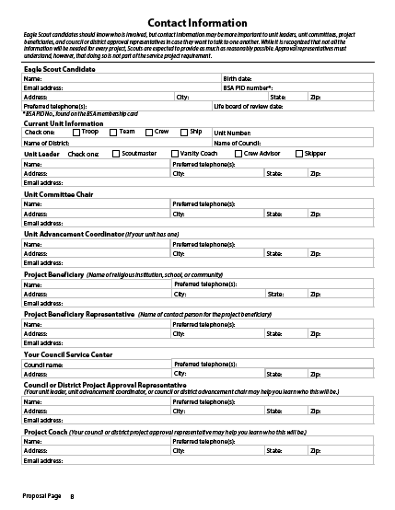
ESSP – Contact Page
Proposal page B
Contact Information
This needs to be completely filled out – Just like a job application
If not applicable – write N/A
District will not review proposal if this page is incomplete.
Council Contact is: Carol Swank, Delmarva Council, 1910 Baden Powell Way, Dover DE 19904 (Not the old Scout Store in Wilm.)

Slide 24



ESSP – Project Description
Project Description and Benefit (MOST IMPORTANT to get this right)
Succinct description of project goal(s) and scope. Describe the work process to be used to complete the project and leadership skills to be employed.
Include sizes, numbers, dimensions, etc. to help define the scope of the project.
Explain the benefit, including the number of people to be affected, and a description of the current condition.
How long will it take and how many people will you lead?
Drawings, Photos, Google view and documents (a must for any area planning)
These are included as extra documents with the proposal document. They will
not be embedded into the workbook.
Include a caption that explains the photo or drawing
Include photos of current condition or where the new item will be located. Give credit to drawings or plans created by others.
Check grammar and spelling – this is the capstone of your Scouting journey, show your best!

Slide 25
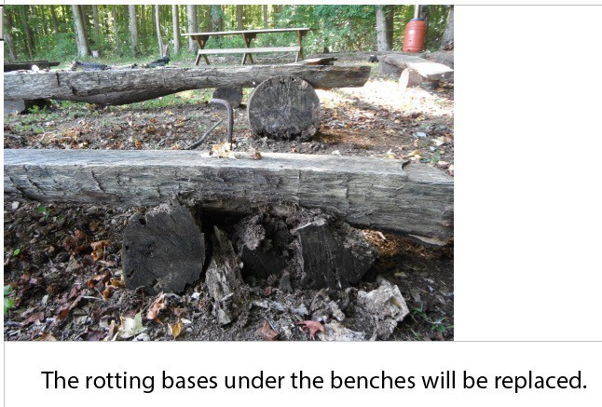
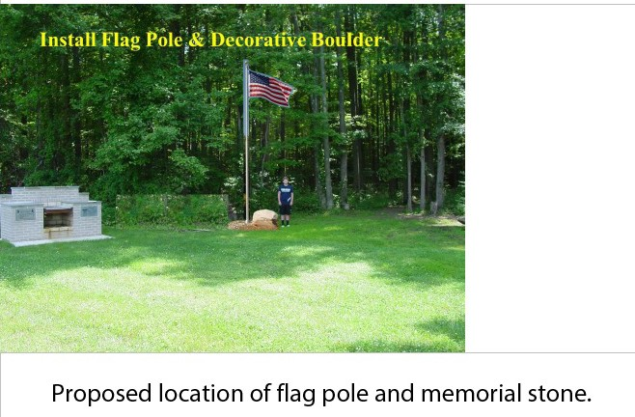
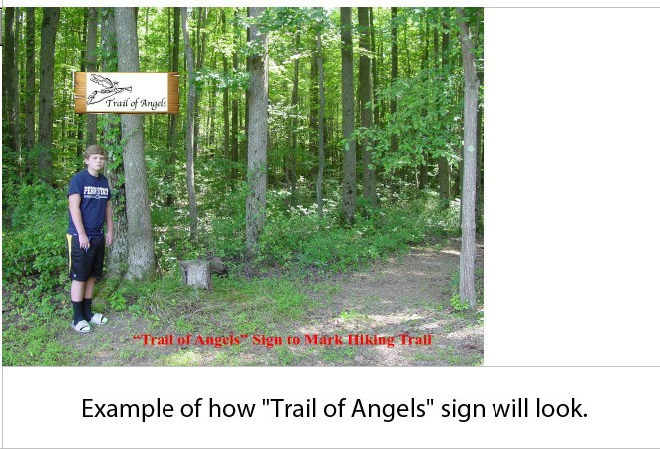
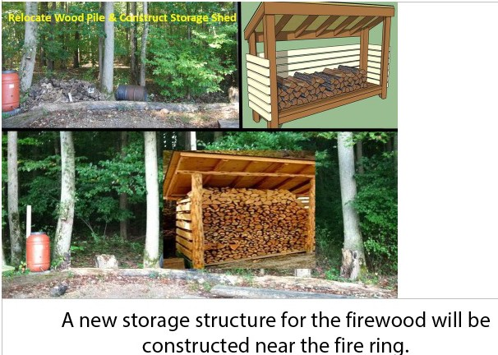
ESSP–Establish the Vision

Slide 26
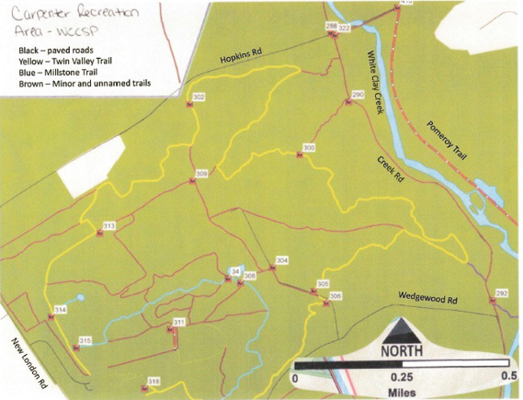
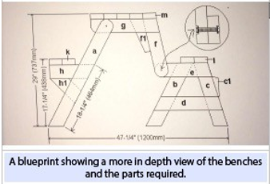
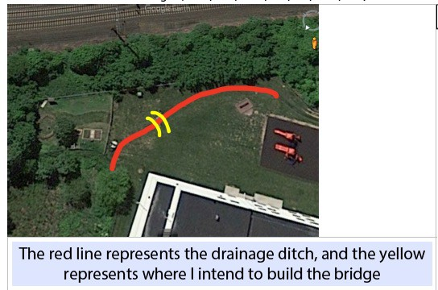
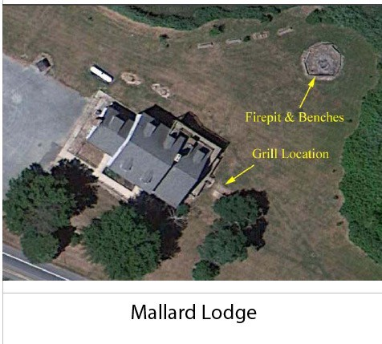
ESSP–Establish the Vision
Examples of other drawings, plans and aerial photos
Map with locations of 17 new trail markers

Slide 27
ESSP – Giving Leadership
How many people will you need to help?
How will you recruit the workers for your project?
What will be most difficult about leading those who are helping?
What leadership skills will be important?

Slide 28

ESSP – Materials, Supplies and Tools
Materials (Stuff used and left behind)
Supplies (Stuff used up)
Tools (Equipment used to complete the project)
All three lists should
These are general lists of items needed to meet the project goals
Be as thorough as you can, does not have to be 100% complete but must show good thought
Does not require detail research for material quantities.
Lists should coincide with safety issues (ie. Dehydration, include water, Power tools, include eye, ear, lung and hand)

Slide 29
ESSP – Permits, Cost and Funding Project
Permits and Permissions
Some projects will require permission beyond that which the beneficiary provides such as building permits or Miss Utility. Indicate these and be sure to allow plenty of extra time to obtain these.
Preliminary Cost Estimates
Will need to do some research to estimate the cost of Materials, Supplies, Tools, and miscellaneous. Do not just make guesses! NOTE: Lumber and many building supplies have gone up significantly over the last several years! Also,
some supplies may be in short supply!!! Seek out contractors for used or surplus
materials!
Should only be considered for things that will be consumed by the project (don’t estimate costs for tools you will borrow).
Fund Raising
Explain with some details how you plan to raise the money for the project. Think of fundraisers that have leadership opportunities.
The Fundraising Application is part of the approved project and must be completed if criteria are met.
Remember that a Scout is Thrifty

Slide 30
ESSP
Fundraising Application
The Eagle Scout Service Project Fundraising Application must be used to obtain approval for service project fundraising or securing donations of materials.
It is not necessary for contributions from the candidate, parents or relatives, the unit or its chartered organization, parents or members of the unit, or the beneficiary.
All money left over, regardless of the source, goes to the beneficiary.
Fundraising Application should be submitted to the Eagle Board of Review Chair along with the project proposal.

Slide 31
ESSP – Phases and Logistics
Project Phases
These are the major steps you will make in completing your entire project from start to finish. Some phases could include:
Complete the final detailed plan
Submit the fundraiser application – (have a plan to make the fundraiser successful!) Fundraiser
Purchase and deliver materials Contact Miss Utility
Complete the fundraiser and project Complete the project workbook
Send thank you’s to those that made my project a success
Logistics
This section explains the plan for how all the project resources will be moved and possibly stored during your project. Other logistics could be the removal of dirt, grass or branches, or the location of nearest bathrooms or electricity.

Slide 32
ESSP – Safety and Further Planning
Safety Issues
List as many potential safety hazards and concerns as you can think of in this section. (Include required items in the Tools, Supplies and Materials sections). Some examples are: Dehydration, Splinters, Hitting fingers with hammers, Puncture wounds, Lacerations, Poisonous plants, electrocution, debris in eyes, loud noise, blisters, etc.. Make sure to check and reference The Guide for Safe Scouting to make sure that jobs and equipment are age-appropriate!
Further Planning
These are the steps you plan to take in completing your detail plan - NOT the steps needed to execute the plan.
Examples: Investigate the best paint for cement blocks outdoors, create a detailed materials list, detailed drawings, determine the best flowers or grass for the area with full sunlight, etc….

Slide 33

ESSP – Signatures
Signatures
The candidate signs their commitment (read before you sign).
Confirms that he or she have read the entire ESSPW
They will lead the project
They will do their BEST to carry it out for MAXIMUM benefit to the religious
institution, school or community they choose as the beneficiary
Unit Leader Unit Committee
Beneficiary – Also confirms that they received a copy of “Navigating the Eagle Scout Service Project, Information for Project Beneficiaries”
Last ➔ Blue Hen District Eagle Chair

Slide 34



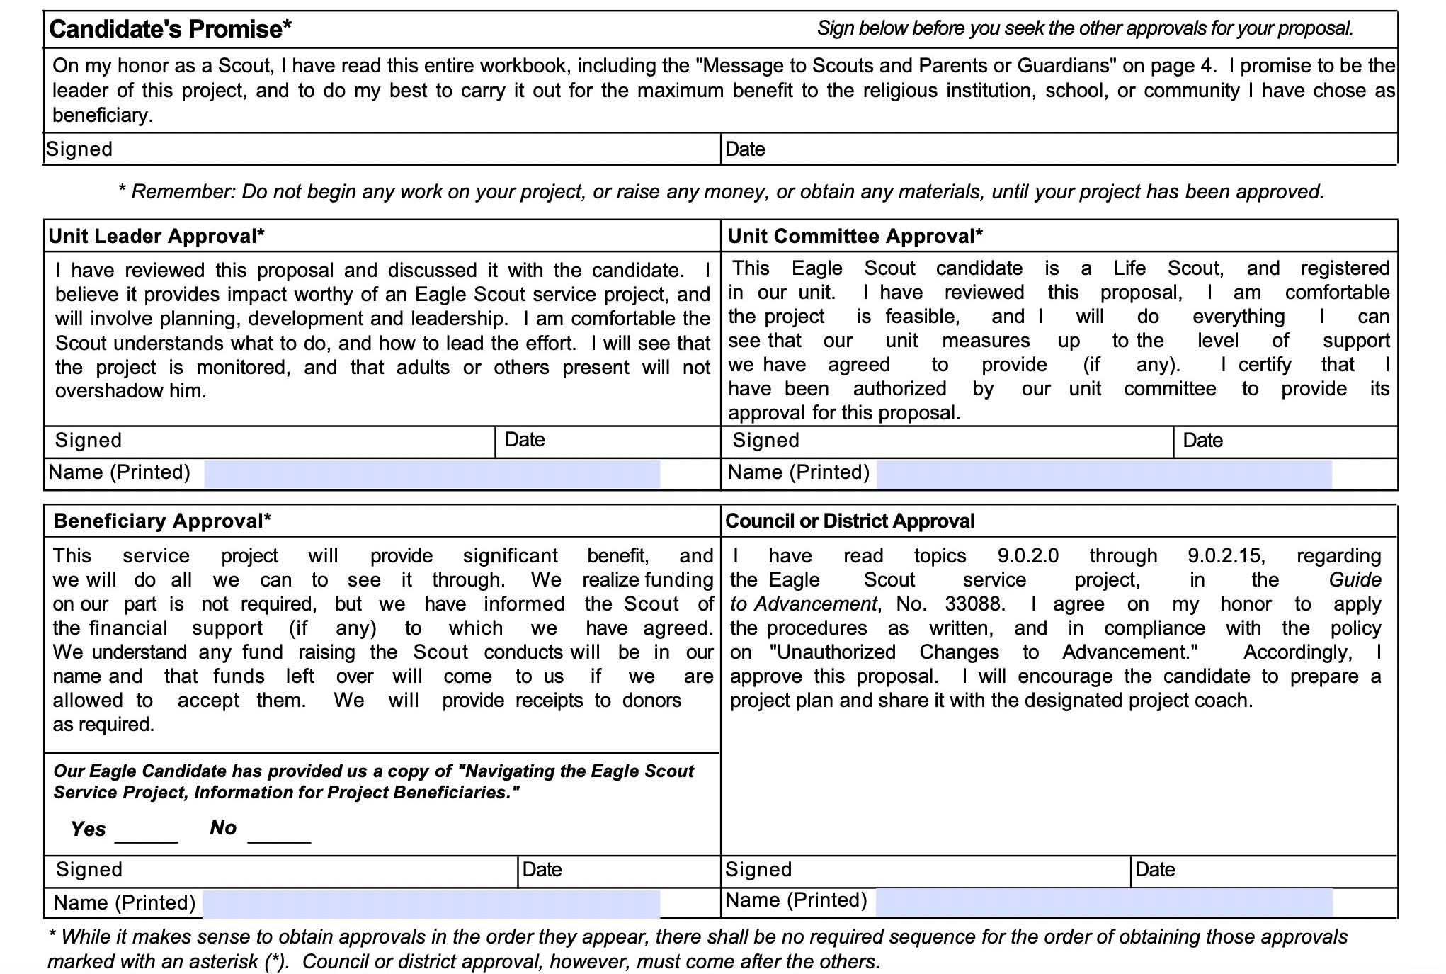
ESSP – Signature Page!
The signature page needs to have all signatures, but the district signature, before district approval sign off.
Make sure YOU sign!
Make sure Beneficiary signature and check box for “Navigating…. “ is complete!

Slide 35
ESSP – How to Submit your Proposal – Blue Hen District North
Submit the Project Proposal directly to the Blue Hen North District Eagle Chair via email:
Blue Hen North – Andy Sensing (asensing@aol.com)
The proposal should be submitted as a .pdf file attached to an email. Copy your Scoutmaster and Eagle Mentor.
The signed signature page must accompany the proposal.
All pictures, diagrams, maps, and other attachments must be included. Pictures should have captions.
Notes:
How to Start
You have earned the Life Scout rank and are ready to begin your Eagle Scout leadership service project. This workbook will help you plan and record your progress and complete and submit a final report.
The Requirement
As stated in the Boy Scout Handbook: While a Life Scout, plan, develop, and give leadership to others in a service project helpful to your religious institution, school, or your community. (The project should benefit an organization other than the BSA.) The project plan must be approved by the organization benefiting from the effort, your unit leader (Scoutmaster, Varsity Scout Coach, Venturing crew Advisor), unit committee, and by the council or district advancement committee before you start. You must use the Eagle Scout Leadership Service Project Workbook, No. 18-927E, or this online equivalent, in meeting this requirement.
Originality
Does the leadership service project for Eagle have to be original, perhaps something you dream up that has never been done before? The answer: No, but it certainly could be. You may pick a project that has been done before, but you must accept responsibility for planning, directing, and following through to its successful completion.
Limitations
Routine labor (a job or service normally rendered) should not be considered.
Projects involving council property or other BSA activities are not acceptable.
Projects may not be performed for businesses.
Projects may not be of a commercial nature.
Projects may not be a fund-raiser. Fund-raising is permitted only for securing materials needed to carry out the project.
Donors to projects must be made aware of what entity is benefiting from the project, and that it clearly is not the Boy Scouts of America.
Any funds raised for a project and not used for the purchase of project materials must be returned to the donors.
Size
How big a project is required? There are no specific requirements, as long as the project is helpful to a religious institution, school, or community. The amount of time spent by you in planning your project and the actual working time spent in carrying out the project should be as much as is necessary for you to demonstrate your leadership of others.
Examples
A look at some projects other Scouts have done for their Eagle Scout Award illustrates that your project can be to construct something or can be to render a service. Scouts have
Made trays to fasten to wheelchairs for veterans with disabilities at a Veterans Administration hospital.
Collected used books and distributed them to people in the community who wanted and needed, but could not afford, books.
Built a sturdy footbridge across a brook to make a safe shortcut for children between their homes and school.
Collected and repaired used toys and gave them to a home for children with disabilities.
Organized and operated a bicycle safety campaign. This involved a written safety test, equipment safety check, and a skills contest in a bike rodeo.
Surveyed the remains of an old Spanish mission and prepared an accurate map relating it to the present church.
Built a “tot lot” in a big city neighborhood and set up a schedule for Boy Scouts to help run it.
Set up a community study center for children who needed a place to do schoolwork.
Trained fellow students as audiovisual aides for their school. Arranged for more than 200 hours of audiovisual work.
Prepared plans for a footbridge on a trail in a national forest. Worked with rangers to learn the skills necessary to build the structure, gathered materials and tools, and then directed a Scout work group to do the construction.
9/15/2008

Slide 36
ESSP – How to Submit your Proposal – Blue Hen District South
Send an email notice to the Blue Hen South Eagle Board Chair that you are ready to submit your Eagle proposal. Mr. White - 70Eagle279@gmail.com. (Note you should cc your SM and mentor. All emails require at least one additional adult to comply with Youth Protection Requirements!). Body of the email should be written using proper etiquette and include a brief introduction of the candidate
Mr. White will send you an invitation to setup a free cloud storage account on www.mega.nz This email will come from directly from mega.nz. (Your cloud account is free and will be yours to use even after your project is approved. However the access to your project folder will be deleted once the approval has been made.)
After you have setup your account you will need to accept Mr. White’s invitation to share your folder on the cloud server.
After you have accepted the invitation notify Mr. White and he will send you a link to your folder.
You will then be able to upload all the required documents necessary for the review and approval of your project.

Slide 37




ESSP – Required Proposal Documentation
Submitted documents must include the following:
One ORIGINAL ESSP Workbook pdf file (not a scan). This should be the newest version – 2023a downloaded from Scouting.org.
Note: We will not accept the older versions due to software incompatibilities with certain versions!
One scan of Signature page (proposal page E) with all signatures, except the one for District Approval.
You need to provide a copy of “Navigating the Eagle Scout Service Project, Information for Project Beneficiaries.” and they need to check the block that they received it.
Optional – Additional pages with photos, drawings, diagrams, illustrations, etc. of locations and items you may build for your project.

Slide 38
ESSP – District Review/Approval
District Eagle Board Chair Approval
Is the Community Benefit within guidelines?
Is the Leadership Opportunity commensurate with the rank of Eagle? Does the candidate know how he or she will complete the detail plan?
May/Often need more information to complete approval – allow 2-4 weeks for the entire process, duration usually depends on response times.
You may be asked to make corrections or additions and resubmit before final approval is given.
Approval is typically communicated by email & will include
Official notice of approval Scan of signature sheet
Recommendations for detail planning
Directions for completing the Eagle Rank application process Keep a copy of this for your Eagle Application

Slide 39




ESSP – Items often
overlooked in the proposal
Contact sheet - empty boxes – all need to be filled in, including Scout ID (PID) and Life BOR date, beneficiary information…..
If you are doing construction, landscaping, remodeling – please include diagrams, plans, and if outside, maps. Maps should show be close to scale and include buildings, roads, landmarks, etc. Use of marked up Googlemaps or similar are acceptable. Pictures should have captions.
Photos of the current location are helpful for the reviewers to better understand the state of the project area. Using a person as reference in a photo is helpful to gauge size, height and distance.
If moving or removing material during the project, explain what you plan to do with it – dirt, grass, old structures – fence picnic tables, shed, etc.
The signature page needs to have all signatures, but the district signature, before district approval sign off.

Slide 40

ESSP – Final Plan
ESSPW – Final Plan pages A to E
Responsibility for completing the “Eagle Scout Service Project Plan” (Detail Plan) section of the workbook
The Eagle Candidate is responsible for completing the Project Workbook.
The Unit Committee & Mentor is responsible for guiding and supporting the candidate (safety, quality, technical aspects).
Timing of completing the Detail Plan
Can start anytime but don’t put too much effort in prior to approval. Is to be complete BEFORE starting work on the project.
Once complete, or nearly complete, share the plan with the Eagle mentor for review and input
The plan is not submitted to the Eagle Board Chair for approval.

Slide 41
ESSP – Fundraising Application
Workbook – Fundraising Application pages A and B
All fundraising activities require prior approval. The Eagle Scout Service Project Fundraising Application must be used to obtain approval for raising money for the service project or securing donations or discounts of materials and supplies.
The Fundraising Application is not necessary for contributions from the candidate, the candidate's parents or relatives, the unit or its chartered organization, unit's parents or members, or the beneficiary. All proceeds left over from fundraising or donations, whether money, materials, supplies, etc., regardless of the source, go to the beneficiary.
The Fundraising Application, with beneficiary and unit leader signatures, should be submitted for approval to the Eagle Board of Review Chair along with the project proposal.
Consider whether your fundraising project will be a major portion of the demonstration of your leadership. Please reference the Fundraising Application Page B in the project workbook.

Slide 42




ESSP - Finishing the Job
Execute the Plan & Complete the ESSP workbook
YOU lead others to accomplish the project goals YOU are responsible for safe working conditions
YOU track work progress, hours worked, money spent, etc. YOU develop solutions to unforeseen challenges
YOU record changes made to the plan including why the change was made
how the solution was decided
Record worker hours – Including Fundraising Thank all of those people, groups or businesses that made your project successful.

Slide 43
ESSP – Eagle Board Assistance
The Eagle Board is always available to answer questions and provide input and/or assistance as needed for your project.
One of our goals is to make sure you have the tools to be successful!
A representative from the Eagle Board can be available for meetings with you and your mentor via:
Zoom
Conference Calls
In Person meetings

Slide 44
ESSP – Project Report
Project completion date is when the project was completed (not when workbook is completed)
Workbook must be completed before Eagle Application
Changes
Leadership demonstrated
Hours you spent planning
Hours you spent carrying out the project
Hours others spent working on the project
Materials (and funds) required to complete project
“After” Photographs of the completed project
Signatures
Eagle candidate signs and dates after completion
Representative of beneficiary organization
Scoutmaster/Coach/Advisor

Slide 45

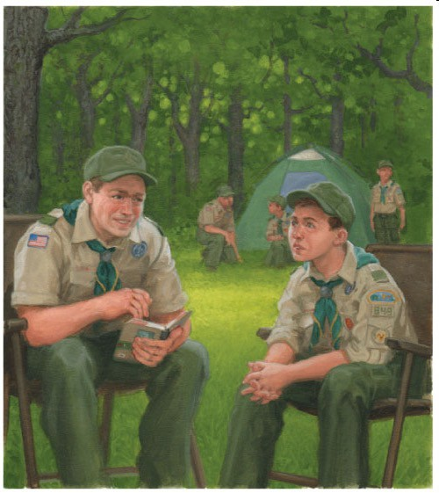
Requirement 6. ULC
Take part in a unit leader conference.
This is the final opportunity for the Unit Leader to review and “test” YOUR readiness for the Rank of Eagle
It must be completed prior to YOUR 18th birthday

Slide 46
Requirement 6. Statement of Ambitions and Life Purpose
Attach to the Eagle application a statement of your ambitions and life purpose and a listing of positions held in your school, camp, community, or other organizations during which you demonstrated leadership skills,
including honors & awards received.
Your Statement of Ambitions and Life Purpose is your opportunity to tell the Eagle Board what you view as your goals for the future! This may include if you plan to seek higher education, attend trade school, go into the military, pursue public service, etc. It may describe how you see or plan your life in the next 5, 10, or more years for a career, a family, community activities, travel, and involvement in Scouting.
You may include your background in Scouting and how it has prepared you for your future but it is not a look back on your past and all the things you did as a Scout. It is your vision of how you see your future and what you intend to do to make it happen!

Slide 47


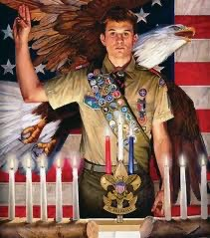
Intermission!

Slide 48
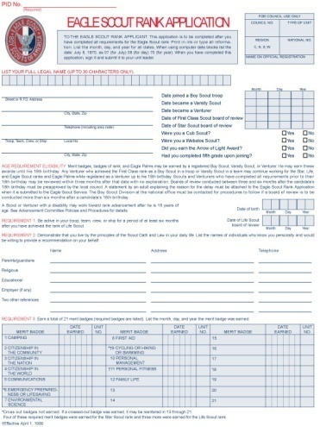
Eagle Rank Application Process
Download Application from Scoutbook.
Fill in the remaining items on the form.
The PDF allows you to type and save data.
Use your full legal name, including middle, which should must match your registration.
Dates of ranks and merit badges should be the date earned – not the date awarded at the Court of Honor.
Notes:
How to Start
You have earned the Life Scout rank and are ready to begin your Eagle Scout leadership service project. This workbook will help you plan and record your progress and complete and submit a final report.
The Requirement
As stated in the Boy Scout Handbook: While a Life Scout, plan, develop, and give leadership to others in a service project helpful to your religious institution, school, or your community. (The project should benefit an organization other than the BSA.) The project plan must be approved by the organization benefiting from the effort, your unit leader (Scoutmaster, Varsity Scout Coach, Venturing crew Advisor), unit committee, and by the council or district advancement committee before you start. You must use the Eagle Scout Leadership Service Project Workbook, No. 18-927E, or this online equivalent, in meeting this requirement.
Originality
Does the leadership service project for Eagle have to be original, perhaps something you dream up that has never been done before? The answer: No, but it certainly could be. You may pick a project that has been done before, but you must accept responsibility for planning, directing, and following through to its successful completion.
Limitations
Routine labor (a job or service normally rendered) should not be considered.
Projects involving council property or other BSA activities are not acceptable.
Projects may not be performed for businesses.
Projects may not be of a commercial nature.
Projects may not be a fund-raiser. Fund-raising is permitted only for securing materials needed to carry out the project.
Donors to projects must be made aware of what entity is benefiting from the project, and that it clearly is not the Boy Scouts of America.
Any funds raised for a project and not used for the purchase of project materials must be returned to the donors.
Size
How big a project is required? There are no specific requirements, as long as the project is helpful to a religious institution, school, or community. The amount of time spent by you in planning your project and the actual working time spent in carrying out the project should be as much as is necessary for you to demonstrate your leadership of others.
Examples
A look at some projects other Scouts have done for their Eagle Scout Award illustrates that your project can be to construct something or can be to render a service. Scouts have
Made trays to fasten to wheelchairs for veterans with disabilities at a Veterans Administration hospital.
Collected used books and distributed them to people in the community who wanted and needed, but could not afford, books.
Built a sturdy footbridge across a brook to make a safe shortcut for children between their homes and school.
Collected and repaired used toys and gave them to a home for children with disabilities.
Organized and operated a bicycle safety campaign. This involved a written safety test, equipment safety check, and a skills contest in a bike rodeo.
Surveyed the remains of an old Spanish mission and prepared an accurate map relating it to the present church.
Built a “tot lot” in a big city neighborhood and set up a schedule for Boy Scouts to help run it.
Set up a community study center for children who needed a place to do schoolwork.
Trained fellow students as audiovisual aides for their school. Arranged for more than 200 hours of audiovisual work.
Prepared plans for a footbridge on a trail in a national forest. Worked with rangers to learn the skills necessary to build the structure, gathered materials and tools, and then directed a Scout work group to do the construction.
9/15/2008

Slide 49
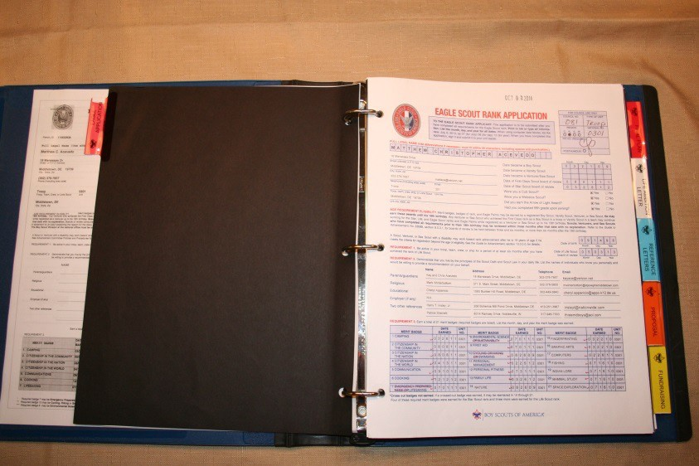
Eagle Rank Application Process
Complete Application requirements 1-6. (Note this includes references supplied by persons in requirement #2!)
Assemble Eagle Rank Application Packet (This is the 21st century – use a computer. No hand written applications!)
Complete the Unit Leader Conference
Obtain final unit signatures on the application
Submit a copy to the Council Registrar via email.
EMAIL packet to Ms. Carol Swank, Council Registrar (cswank@delmarvacouncil.org) as pdf files.
Copy the District Eagle Chair on the email to Ms. Swank.

Slide 50
Eagle Rank Application Process
Your Application documentation should include:
The Eagle Rank Application - checked for errors. Latest version is January, 2025
Copies of the Individual Progress, Individual History, and the Individual Participation reports from TroopMaster, or Scoutbook.
Your project approval email you received from the district allowing you to proceed. Also, include all additional communications you may have received from the District committee.
The complete Eagle Scout Leadership Service Project (ESLSP) with required signatures. Extra pictures, receipts, flyers, thank you letters, and planning documents that you used can and should also be included
Your Statement of Life Ambitions and Goals and Extra-Scouting Leadership and Honors

Slide 51
Eagle Rank Application Process
At least 6 months after Life Board of Review
Dates of Requirements 4 and 5 (position of responsibility and service project) must be on or before date of Scoutmaster conference (Requirement 6)
Date of Final Project signature (Requirement 5) matches the date on Workbook
Date of Applicant’s Signature is after Requirement 6 and before Unit Approval. Signature of unit leaders in any order, but after conference
All signatures before applicant’s 18 birthday
Notes:
How to Start
You have earned the Life Scout rank and are ready to begin your Eagle Scout leadership service project. This workbook will help you plan and record your progress and complete and submit a final report.
The Requirement
As stated in the Boy Scout Handbook: While a Life Scout, plan, develop, and give leadership to others in a service project helpful to your religious institution, school, or your community. (The project should benefit an organization other than the BSA.) The project plan must be approved by the organization benefiting from the effort, your unit leader (Scoutmaster, Varsity Scout Coach, Venturing crew Advisor), unit committee, and by the council or district advancement committee before you start. You must use the Eagle Scout Leadership Service Project Workbook, No. 18-927E, or this online equivalent, in meeting this requirement.
Originality
Does the leadership service project for Eagle have to be original, perhaps something you dream up that has never been done before? The answer: No, but it certainly could be. You may pick a project that has been done before, but you must accept responsibility for planning, directing, and following through to its successful completion.
Limitations
Routine labor (a job or service normally rendered) should not be considered.
Projects involving council property or other BSA activities are not acceptable.
Projects may not be performed for businesses.
Projects may not be of a commercial nature.
Projects may not be a fund-raiser. Fund-raising is permitted only for securing materials needed to carry out the project.
Donors to projects must be made aware of what entity is benefiting from the project, and that it clearly is not the Boy Scouts of America.
Any funds raised for a project and not used for the purchase of project materials must be returned to the donors.
Size
How big a project is required? There are no specific requirements, as long as the project is helpful to a religious institution, school, or community. The amount of time spent by you in planning your project and the actual working time spent in carrying out the project should be as much as is necessary for you to demonstrate your leadership of others.
Examples
A look at some projects other Scouts have done for their Eagle Scout Award illustrates that your project can be to construct something or can be to render a service. Scouts have
Made trays to fasten to wheelchairs for veterans with disabilities at a Veterans Administration hospital.
Collected used books and distributed them to people in the community who wanted and needed, but could not afford, books.
Built a sturdy footbridge across a brook to make a safe shortcut for children between their homes and school.
Collected and repaired used toys and gave them to a home for children with disabilities.
Organized and operated a bicycle safety campaign. This involved a written safety test, equipment safety check, and a skills contest in a bike rodeo.
Surveyed the remains of an old Spanish mission and prepared an accurate map relating it to the present church.
Built a “tot lot” in a big city neighborhood and set up a schedule for Boy Scouts to help run it.
Set up a community study center for children who needed a place to do schoolwork.
Trained fellow students as audiovisual aides for their school. Arranged for more than 200 hours of audiovisual work.
Prepared plans for a footbridge on a trail in a national forest. Worked with rangers to learn the skills necessary to build the structure, gathered materials and tools, and then directed a Scout work group to do the construction.
9/15/2008

Slide 52
Eagle Rank Application Process Reference Letters
List the names of individuals who know you personally and would be willing to write a letter of recommendation on your behalf.
Some units provide a form letter explaining the purpose of the recommendation, the qualifications and requirements for Eagle, and where recommendations should be sent.
The troop should have a process for collecting and submitting the letters. Most troops have the letters sent to the Unit Leader or Unit Advancement Chair and they are then forwarded to the District Eagle Board Chair. Letters should not be sent/given to the Eagle candidate.
Note that an Eagle Board of Review committee member may contact these people for additional information.
Notes:
How to Start
You have earned the Life Scout rank and are ready to begin your Eagle Scout leadership service project. This workbook will help you plan and record your progress and complete and submit a final report.
The Requirement
As stated in the Boy Scout Handbook: While a Life Scout, plan, develop, and give leadership to others in a service project helpful to your religious institution, school, or your community. (The project should benefit an organization other than the BSA.) The project plan must be approved by the organization benefiting from the effort, your unit leader (Scoutmaster, Varsity Scout Coach, Venturing crew Advisor), unit committee, and by the council or district advancement committee before you start. You must use the Eagle Scout Leadership Service Project Workbook, No. 18-927E, or this online equivalent, in meeting this requirement.
Originality
Does the leadership service project for Eagle have to be original, perhaps something you dream up that has never been done before? The answer: No, but it certainly could be. You may pick a project that has been done before, but you must accept responsibility for planning, directing, and following through to its successful completion.
Limitations
Routine labor (a job or service normally rendered) should not be considered.
Projects involving council property or other BSA activities are not acceptable.
Projects may not be performed for businesses.
Projects may not be of a commercial nature.
Projects may not be a fund-raiser. Fund-raising is permitted only for securing materials needed to carry out the project.
Donors to projects must be made aware of what entity is benefiting from the project, and that it clearly is not the Boy Scouts of America.
Any funds raised for a project and not used for the purchase of project materials must be returned to the donors.
Size
How big a project is required? There are no specific requirements, as long as the project is helpful to a religious institution, school, or community. The amount of time spent by you in planning your project and the actual working time spent in carrying out the project should be as much as is necessary for you to demonstrate your leadership of others.
Examples
A look at some projects other Scouts have done for their Eagle Scout Award illustrates that your project can be to construct something or can be to render a service. Scouts have
Made trays to fasten to wheelchairs for veterans with disabilities at a Veterans Administration hospital.
Collected used books and distributed them to people in the community who wanted and needed, but could not afford, books.
Built a sturdy footbridge across a brook to make a safe shortcut for children between their homes and school.
Collected and repaired used toys and gave them to a home for children with disabilities.
Organized and operated a bicycle safety campaign. This involved a written safety test, equipment safety check, and a skills contest in a bike rodeo.
Surveyed the remains of an old Spanish mission and prepared an accurate map relating it to the present church.
Built a “tot lot” in a big city neighborhood and set up a schedule for Boy Scouts to help run it.
Set up a community study center for children who needed a place to do schoolwork.
Trained fellow students as audiovisual aides for their school. Arranged for more than 200 hours of audiovisual work.
Prepared plans for a footbridge on a trail in a national forest. Worked with rangers to learn the skills necessary to build the structure, gathered materials and tools, and then directed a Scout work group to do the construction.
9/15/2008

Slide 53
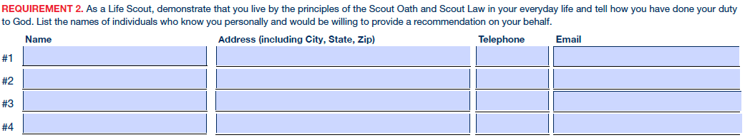
Eagle Rank Application Process Reference Letters
Written reference letters are to be submitted separately by your Scoutmaster or Advancement Chair from a list you have provided to them.
Reference letters should match the list on the Eagle Application
If the required references are not listed on the application, Mrs. Swank will return the application for revision.

Slide 54
Eagle Rank Application Process Reference Letters
Reference letters should be sent directly to the Eagle Board of Review Chair
A Scout cannot have a Board of Review denied or postponed because the District Eagle Chair does not receive letters of recommendation.
If no letters are received, the Scoutmaster will be contacted prior to the Board of Review.
Recommendation letters are confidential, and their contents are not to be disclosed to any person who is not a member of the Board of Review.

Slide 55
Requirement 7. Successfully Complete an Eagle Board of Review
When the completed application is received at the council service center its contents will be verified by the Registrar.
Any issues will be resolved by the Council Registrar working with the Scoutmaster and Eagle candidate.
After the contents of an application have been verified and appropriately signed by the Council Registrar, the Eagle Application Packet will be transferred to the District Eagle Board Chair so that a Board of Review may be scheduled.
A Board of Review will not be scheduled until the application packet is received by the chair of the Eagle Board of Review.
Notes:
9/15/2008

Slide 56
Requirement 7. Successfully Complete an Eagle Board of Review
Registrar validates application, confirms that all information is included and notifies Eagle Board Chair to schedule the Eagle Board of Review.
Eagle Board is scheduled with the Candidate by the Eagle Board Chair
Conduct Board of Review (Board make-up may vary between Districts). Make sure to look your best for your Eagle Board of Review!
Wear your sash with all merit badges
You should have all current rank and other patches on your uniform. Wear any Scout awards, medals, knots, etc.
Bring your Scoutbook to be signed by the Board members
Council Scout Executive Approval. National approval.
Award materials are available 4-6 weeks after Eagle Board of Review is complete.
Troop/Crew Conducts Eagle Court of Honor.

Slide 57

Eagle Board of Review Scheduling
Our goal is to schedule all Boards within four to six weeks after receiving the packet from Council. This enables the Eagle Board Chair to manage the queue and allows the Board time to contact references, read the packet, and visit the project site, if desired.
The candidate and Scoutmaster are notified by email of the date, time, and location of the Eagle Scout Board of Review.
If you must reschedule, contact the Eagle Board Chair immediately.
Eagle Boards in Northern Blue Hen District:
Eagle Scout Boards of Review are usually held on Sunday evening; up to twice each month
Eagle Boards in Southern Blue Hen District
Eagle Scout Boards of Review are usually held on the second and fourth Monday evenings
Notes:
9/15/2008

Slide 58
Eagle Board of Review Purpose
The Eagle Board of Review will review and approve the manner in which the Eagle Scout Service Project was carried out.
The Board will review the candidate’s participation in the Scouting program, the statement of ambitions and life purpose, and demonstrations of leadership and the Scout Oath and Law outside of Scouting.
The Board will consider how well the candidate will represent the values and fulfill the responsibilities of an Eagle Scout.
The Scout should bring a hard copy of the Eagle application packet and the Scout Handbook to the Board of Review.
Notes:
9/15/2008

Slide 59
What to expect in your Eagle Board of Review
The Board will last approximately 45 minutes to 1 hour. This will be an in-person board. Zoom is optional but not recommended unless the Scout cannot attend at the designated location.
The board will consist of approximately 3-5 adult Scouters from Blue Hen District and may include a member of your troop committee. Your Scoutmaster will also be in attendance but only to act as your advocate and for support and will not participate in the Review. No other individuals will be allowed to attend the Board session until a decision on your application is made.
During your board you will be asked a number of questions of which there is no right or wrong answer. Some will be questions of your Scouting history, some will be about your thoughts of the Scouting program, The Scout Law, Scout Oath, etc., and there will be questions about your project.
Following the interview period the Board will meet without the candidate or Scoutmaster and will determine whether the candidate passed the Board. The decision must be unanimous.

Slide 60


Examples of Board Questions
There is no specific set of questions that an Eagle candidate should be asked.
There are no right or wrong answers, but simple yes and no answers are rarely sufficient. A thorough discussion of the candidate’s successes and experiences in Scouting should be considered.
Tell us what merit badge you learned the most?
What was your favorite experience in your Troop? What is your style of leadership?
What is your favorite meal to cook on a campout, and why?
What would you change about the Scouting program if you could?
How do you deal with leading Scouts that are older than you, younger than you?
What does ”Duty to God” mean to you?

Slide 61
Eagle Board of Review Decision
When the Board’s deliberations are complete, the candidate is asked to return.
If the Board of Review was acceptable, the candidate is informed of the Board’s decision to recommend award of the Eagle Scout rank.
If the candidate does not meet the requirements, the candidate is told the reasons for failure to qualify. A discussion will be held as to how the requirements may be met within a given period and the Board of Review will be adjourned until then. Should the applicant disagree with the decision, the appeal procedures should be explained.
Notes:
9/15/2008

Slide 62
Eagle Application
Council Review
After the Board of Review and after the application has been appropriately signed, the signed Eagle Application is returned to the council service center.
When the application arrives at the Council service center, the Scout executive signs it to certify that the proper procedure has been followed and that the Board of Review has recommended the candidate for the Eagle Scout rank.
Only the Eagle Scout Rank Application is forwarded to the national Eagle Scout Service.

Slide 63

Eagle Application Review by National
The Eagle Scout Service screens the application.
Any item not meeting national standards will cause the application to be returned for more information.
Eagle Scout certificate is sent to the local council. The date used on the certificate will be the date of the Board of Review. The Eagle Scout Court of Honor should not be scheduled until the local council receives the Eagle Scout rank credentials.
The Eagle patch, medal and pins may be purchased from the Council Scout Shop.
After earning the Eagle Scout Award, a Scout may work to earn Eagle Palms before the Scout’s 18th birthday. Palms must be earned one at a time, in the order of Bronze, Gold, and then Silver.
Notes:
9/15/2008

Slide 64




Eagle Rank Resources
Website URL – Subject to Change
Eagle Scout Service Project Workbook and Procedures. NEW for 2023
http://www.scouting.org/programs/scouts=bsa/advancement-and -awards/eagle-scout-workbook/
Eagle Application (PDF). (Jan 2025 rev.) http://www.scouting.org/filestore/pdf/512-728_WB_fillable.pdf
Guide to Safe Scouting. http://www.scouting.org/scoutsource/HealthandSafety/GSS.aspx
Guide to Advancement. New for 2025
http://www.scouting.org/scoutsource/GuideToAdvancement.aspx
Age Guidelines for Tool Use and Work at Elevations or Excavations.
http://www.scouting.org/filestore/healthsafety/pdf/680-028.pdf

Slide 65
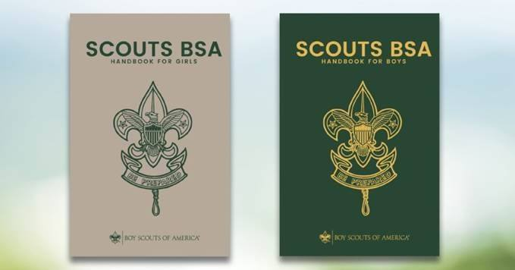
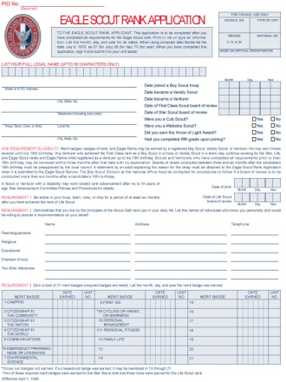
Everything you need to know is in:
Boy Scout Handbook
Eagle Scout Service Project Workbook
Eagle Scout Rank Application

Slide 66
Extension Requests
If a Scout foresees that due to no fault or choice of his or her own, it will be impossible to complete the Eagle Scout rank requirements before age 18 may apply to the local council for a limited time extension. These should be granted only when necessary and are reserved only for work on Eagle. In most cases, unless the National Council has issued other direction, a request must meet the three tests listed below to be approved.
Test #1: The member joined or rejoined (or became active again after a period of inactivity, or became refocused on advancement after a period of inattention) in time to complete all requirements before turning 18.
Test #2: Through no fault or choice of the Scout, an unforeseen circumstance or life changing event with severe consequences has come to exist that now precludes completion of the requirements before the deadline.
Test #3: The circumstance is beyond the control of the Scout, could not have been anticipated or planned for, and was not or cannot be resolved in time to complete the requirements.
Extensions are never guaranteed! Extensions are only approved in emergency circumstances as noted above. DO NOT RELY on an EXTENSION!

Slide 67

Good Turn for America
Record Your Eagle Scout Project in Good Turn for America
You will need to have the Eagle Scout project workbook handy.
Input the data requested:
• The applicant’s full name
• The project completion date
• Number of Scouts working on the project
• Number of non-Scout youth working on the project
• Number of leaders working on the project
• Number of other adults working on the project
• Total hours worked on the
• Cost of materials required to complete the project
• Project category (selected from the dropdown box)
• Type of group benefiting from the project
• The specific group that benefited from the project
Notes:
9/15/2008

Slide 68



Discussion & Questions

