Slide 2
A Continuous Cycle
  Prospecting
  Making The Ask
  Onboarding
  Mentorship
  Succession Planning

Slide 3

  Look Around
  Engage current leaders in the process
  Find new families who are likely to stick around
  Determine Skill Set needed
  Conduct a Parent Survey

Slide 4
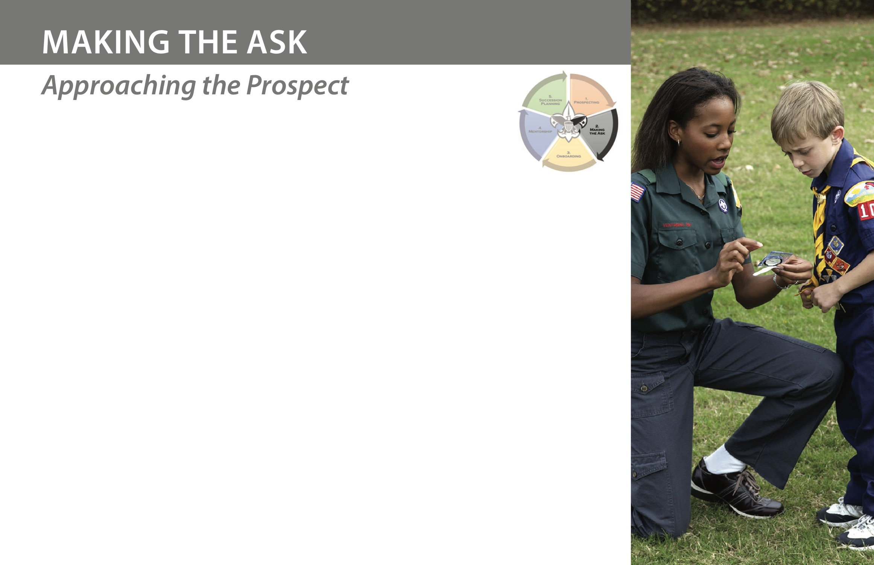
  Prepare yourself
  Setting & Location
  “The Ask” Itself
  Follow-Up Immediately
  If You Receive a “Yes”
  If You Receive a “No”

Slide 5
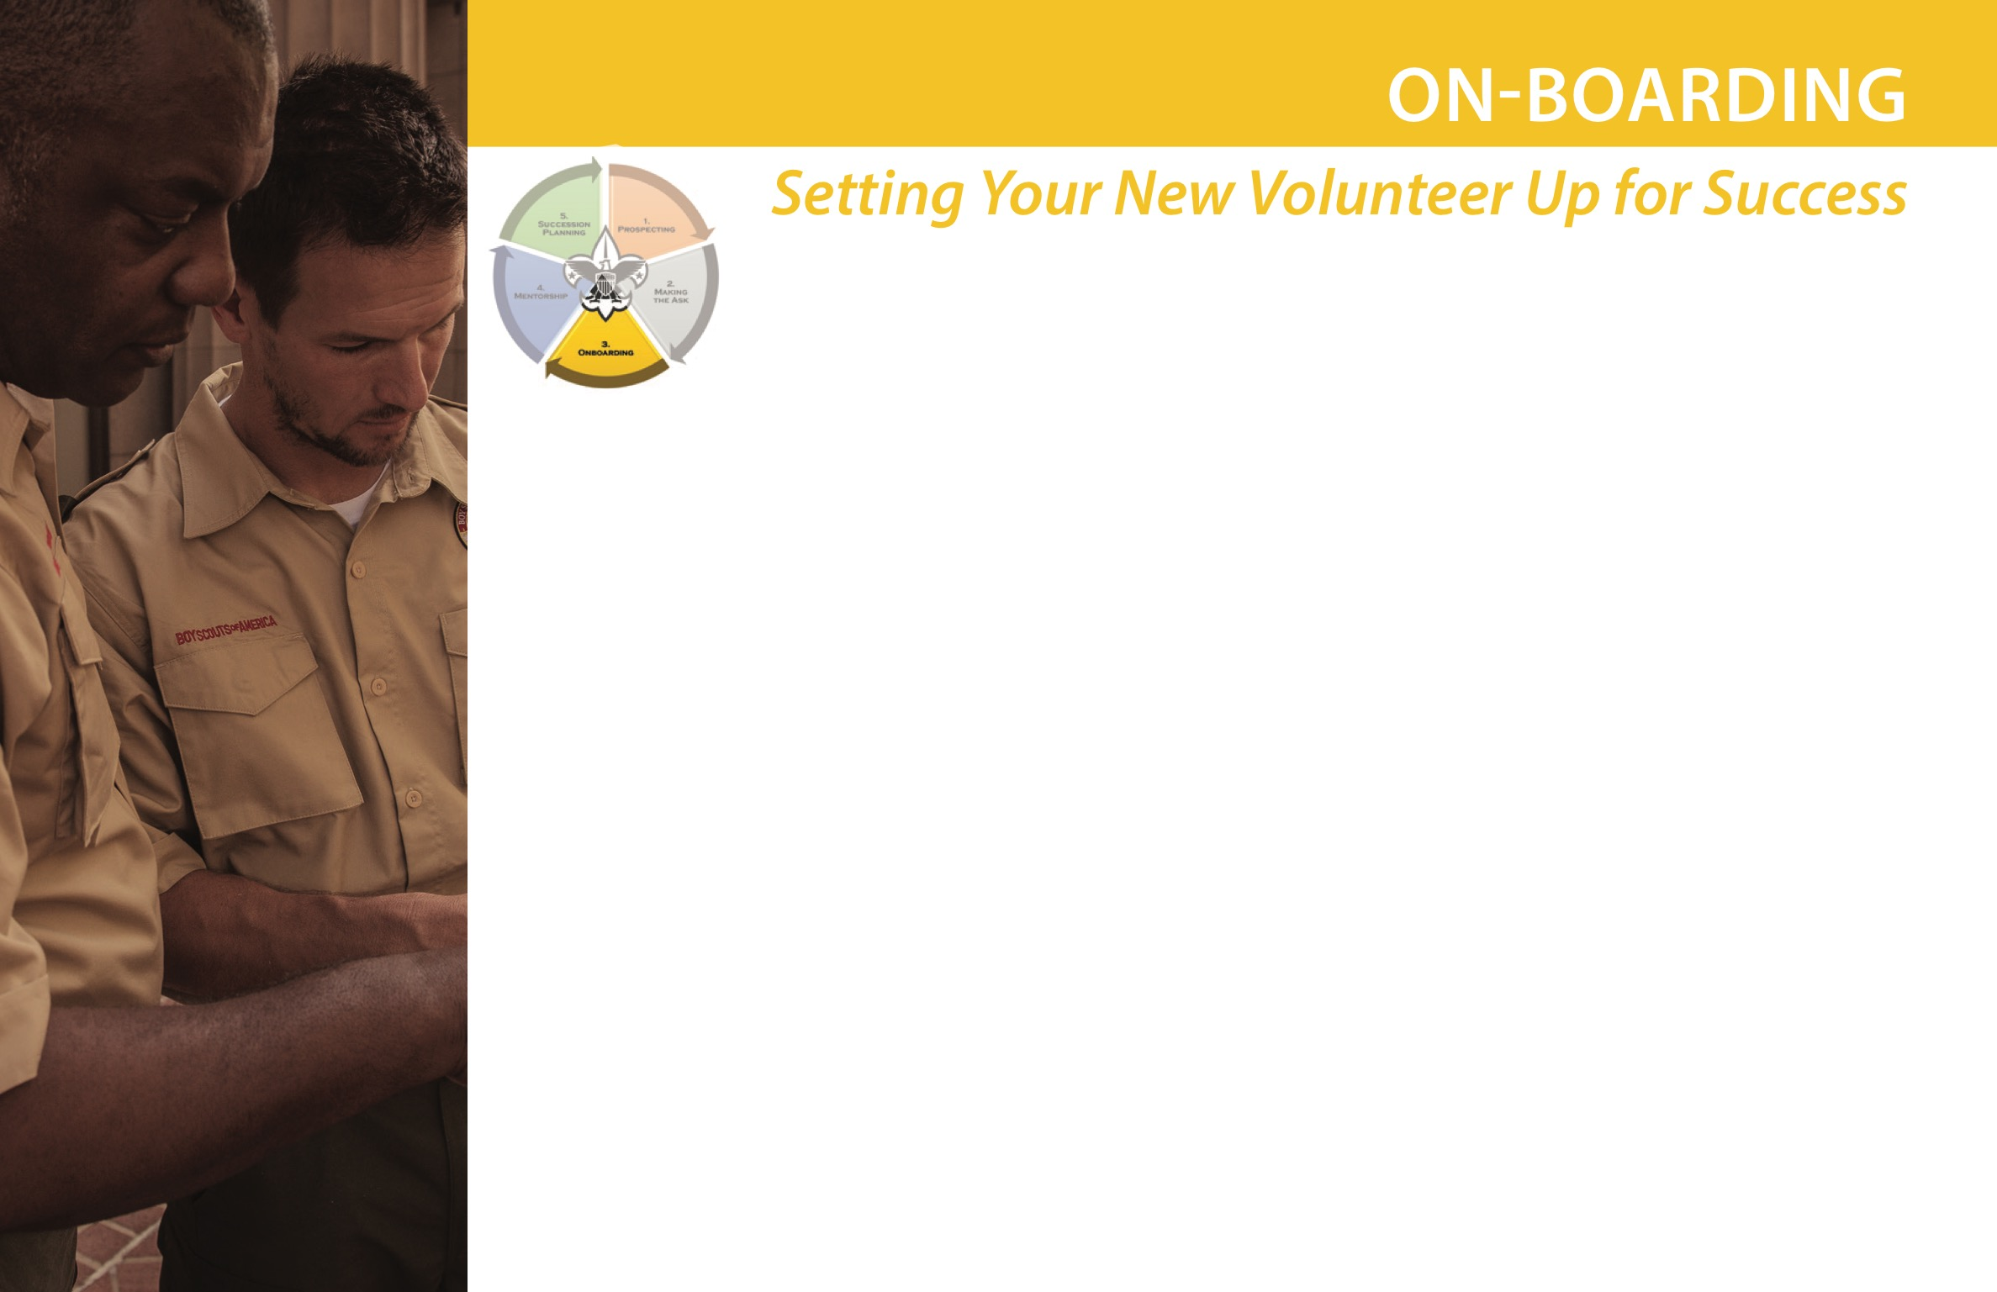
  Explain the Role Fully
  Get Them to Take the Necessary Training
  Announce the New Volunteers role
  Encourage Volunteer-Shadowing
  Conduct a Transition Ceremony
  Create a list of priorities
  Meet key volunteers & staff

Slide 6
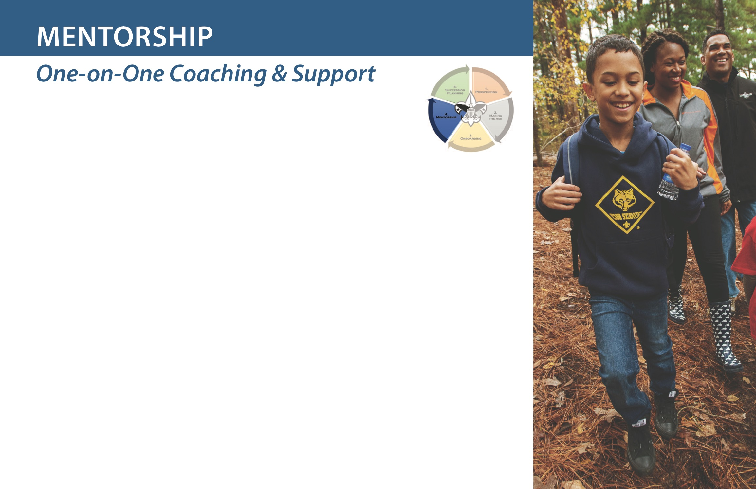
  Share & review documentation
  Review annual calendar together
  Be encouraging & patient
  Define the mentorship duration

Slide 7
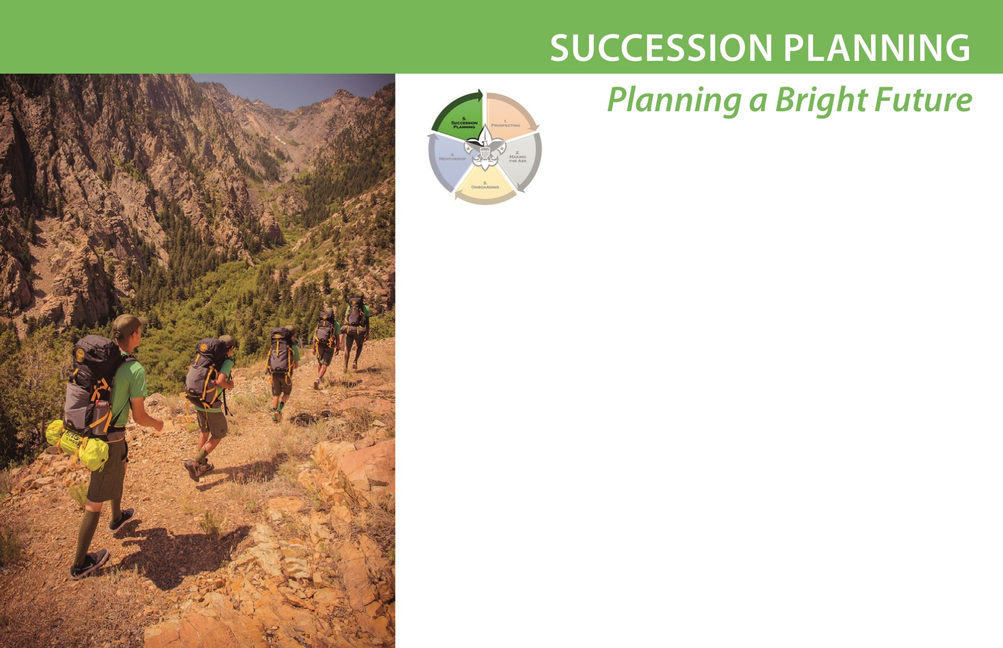
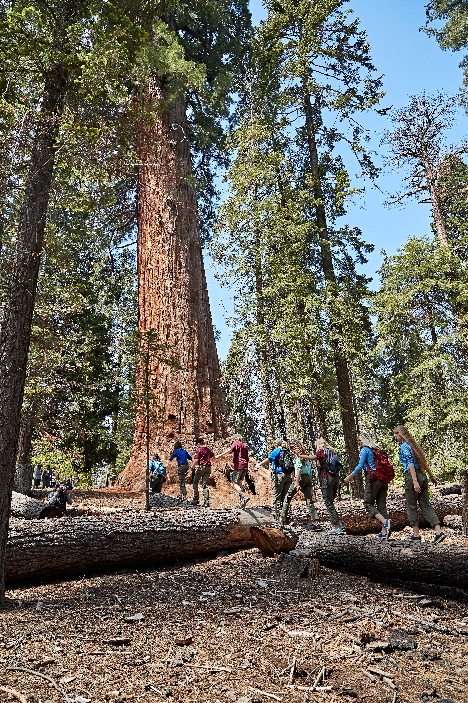
  Start Early!
  Re-evaluate Leadership Roles Annually
  Maintain Communication with key leaders and parents

Slide 8

THANK YOU!
Visit www.delmarvacouncil.org/volunteer-hub/ for additional Volunteer Recruitment resources.

